Slide 1
Single Cell Present and (near) Future
David McGaughey, Ph.D.
OGVFB | NEI | NIH
2020 - 04 - 13
Notes:
20 minutes!
Hi, thanks for the invitation to speak to you all, it’s a big honor.
I’m a staff scientist (bioinformatics core) at 3NEI and I don’t have a lab. Or a budget. But I do manage to do some independent research because the community has to deposit the raw RNA-seq data when they publish a paper.
I’ll be discussing my work integrating everyone’s sequence data to create an ocular gene expression atlas.

Slide 2
Borrowed heavily from two sources
Lior Pachter
Kallisto, bustools
https://figshare.com/articles/Introduction_to_single-cell_RNA-seq_technologies/7704659
OSCA group (Aaron Lun, Stephanie Hicks, Robert Amezquita, Raphael Gottardo)
https://osca.bioconductor.org

Slide 3
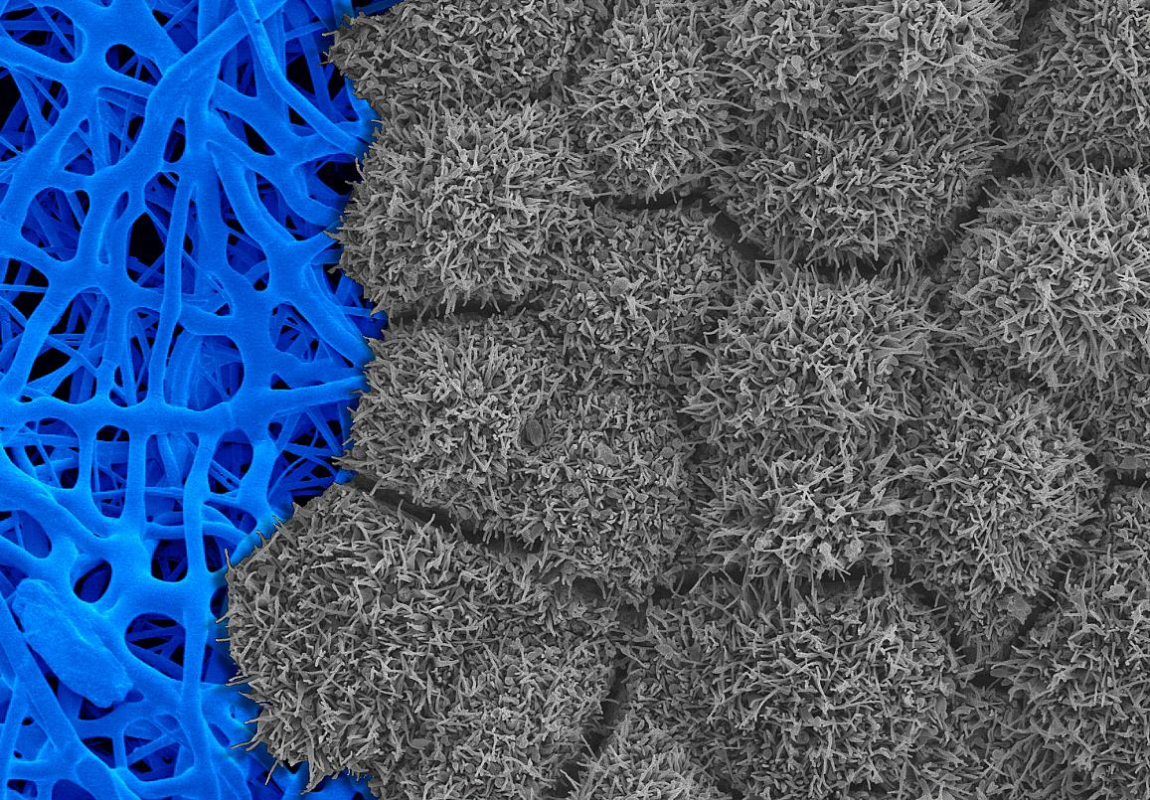
What is single cell (sc)?
Quantitation of [ ] in and across single cells
Isn’t that microscopy?
EM of RPE (ciliated, gray) against an artificial scaffold (blue)
https://doi.org/10.1172/JCI131187.

Slide 4
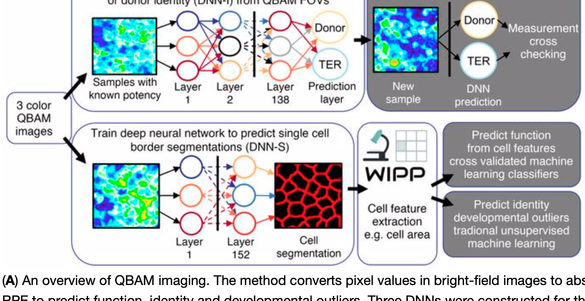
Microscopy + Computation = scPhenotype
Why not?
From imaging, you can quantify many cell characteristics
Volume
Shape
Count
Morphology
https://doi.org/10.1172/JCI131187

Slide 5
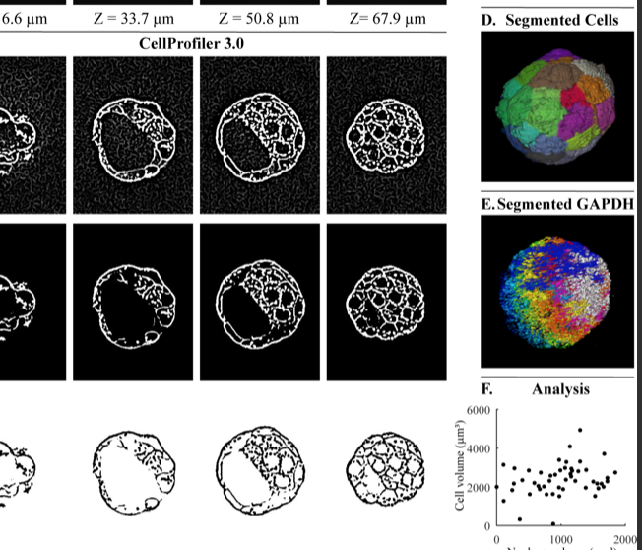
Software Platforms for Quantitative Microscopy
CellProfiler
NIH Image / FIJI
https://doi.org/10.1371/journal.pbio.2005970

Slide 6
OK, but what do we really mean we when say “single-cell [BLANK]?”
Where [BLANK] is RNA, ATAC, ChIP, etc.

Slide 7
The goal
Goal is sensitive and specific quantification of [BLANK] in (or on!) a single cell, across all (?) cells in the tissue/dish
RNA
transcripts (mRNA)
(By far, most popular)
ATAC
Open chromatin
ChIP
Binding positions of Ab (usually specific histones, TF)

Slide 8
The goal, more precisely
Universal in terms of cell size, type and state.
In situ measurements.
No minimum input of number of cells to be assayed.
Every cell is assayed, i.e.100% capture rate.
Every [BLANK] in every cell is detected, i.e.100% sensitivity.
Every [BLANK] is identified by its full-length sequence.
[BLANKS] are assigned correctly to cells, e.g. no doublets.
Additional multimodal measurements.
Cost effective per cell.
Easy to use.
Open source.
[BLANK] could be:
transcript
open chromatin
Ab binding event
Content from https://figshare.com/articles/Introduction_to_single-cell_RNA-seq_technologies/7704659

Slide 9
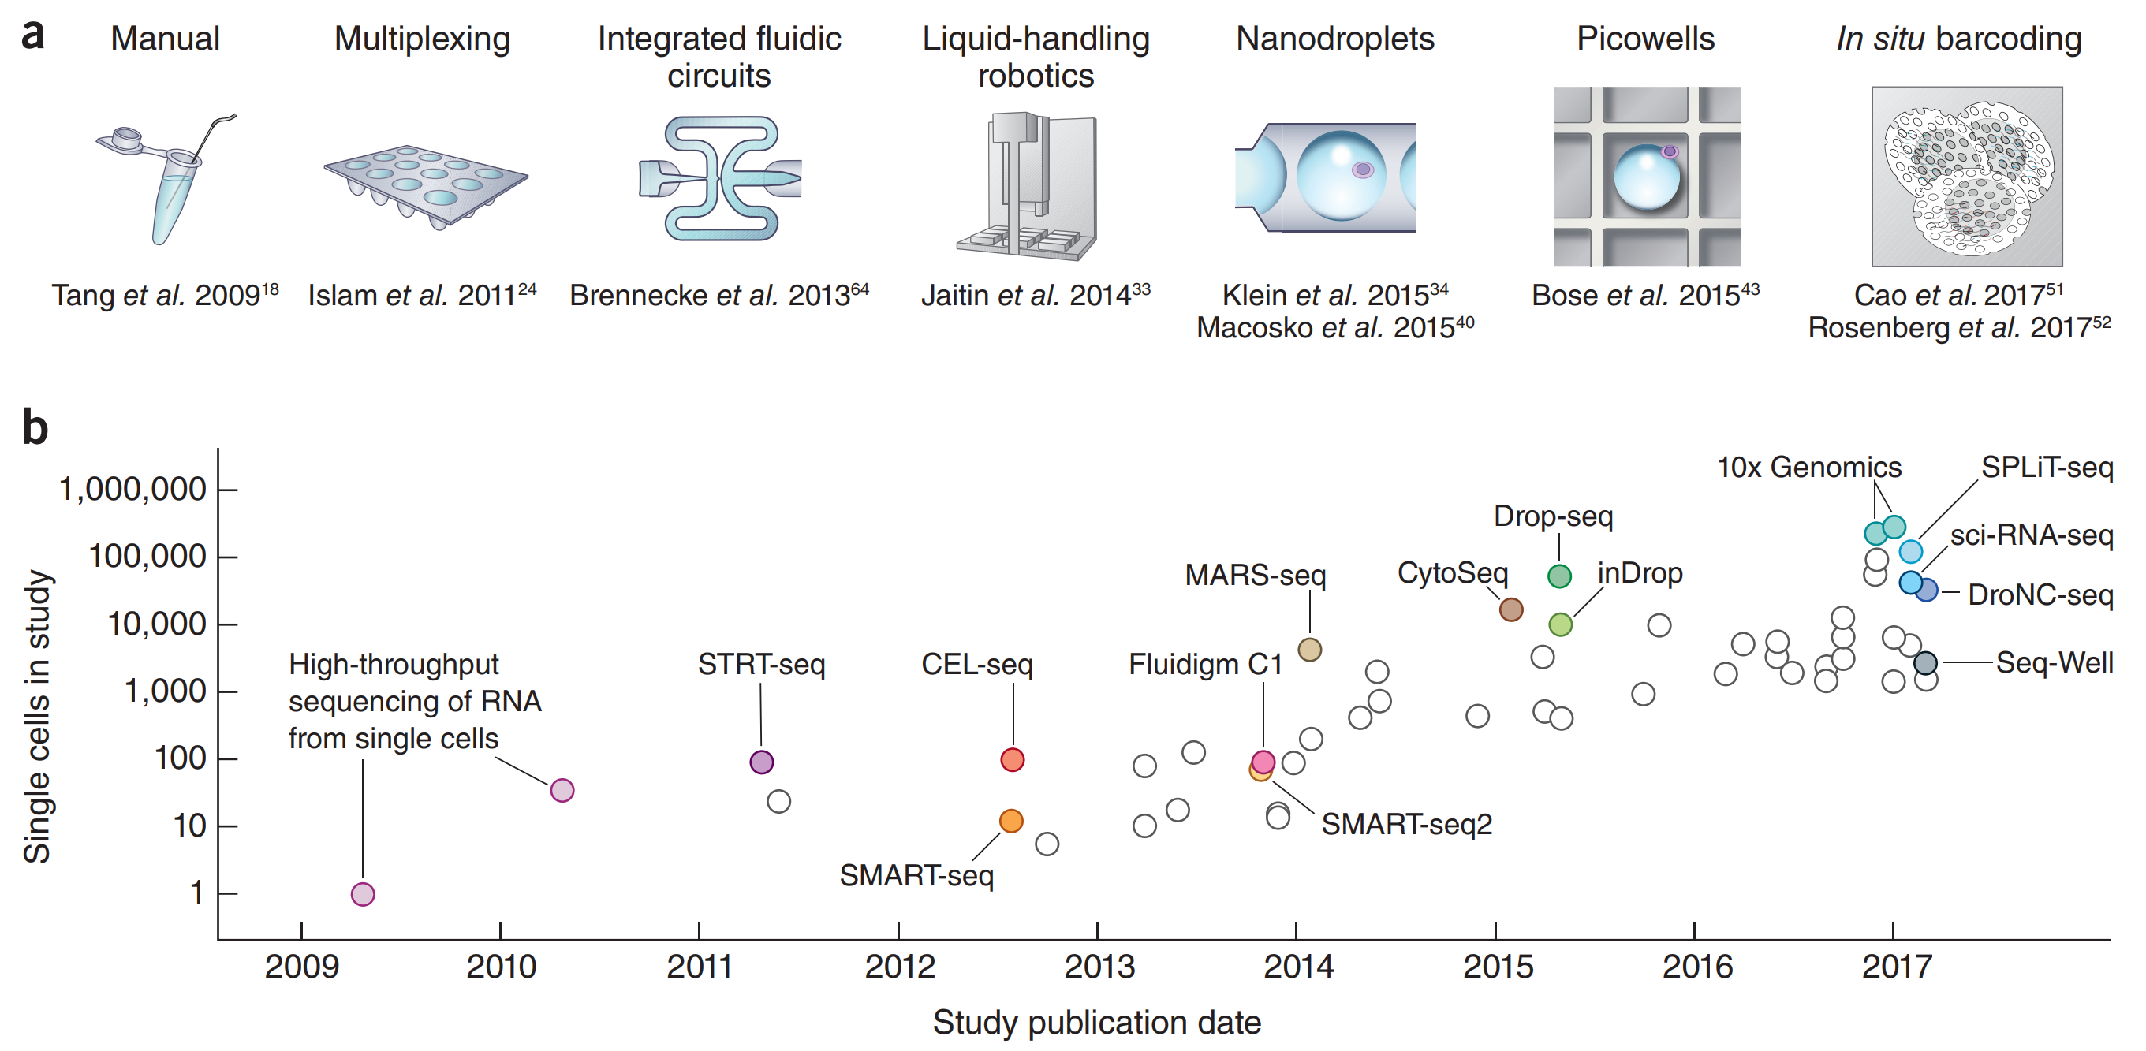
A decade of single-cell RNA-seq
Content from https://figshare.com/articles/Introduction_to_single-cell_RNA-seq_technologies/7704659
Svensson et al. 2018. DOI:10.1038/nprot.2017.149

Slide 10
Example: SMART-Seq2 performance
Universal in terms of cell size, type and state.
In situ measurements.
No minimum input of number of cells to be assayed.
Every cell is assayed, i.e.100% capture rate.
Every transcript in every cell is detected, i.e.100% sensitivity.
Every transcript is identified by its full-length sequence.
Transcripts are assigned correctly to cells, e.g. no doublets.
Additional multimodal measurements.
Cost effective per cell.
Easy to use.
Open source.
*Positive
*Ok
*Negative
Content from https://figshare.com/articles/Introduction_to_single-cell_RNA-seq_technologies/770465

Slide 11
Example: 10X performance
Universal in terms of cell size, type and state.
In situ measurements.
No minimum input of number of cells to be assayed.
Every cell is assayed, i.e.100% capture rate.
Every transcript in every cell is detected, i.e.100% sensitivity.
Every transcript is identified by its full-length sequence.
Transcripts are assigned correctly to cells, e.g. no doublets.
Additional multimodal measurements.
Cost effective per cell.
Easy to use.
Open source.
*Positive
*Ok
*Negative
Heavily altered from https://figshare.com/articles/Introduction_to_single-cell_RNA-seq_technologies/7704659

Slide 12
2020+ Tech Thrusts
Multimodal
Simultaneous quantification of [>=2 BLANK] in a single cell
Full length
Sequence all DNA instead of a snippet
Spatial
Retain knowledge of WHERE every single cell is in a 3D/4D space

Slide 13
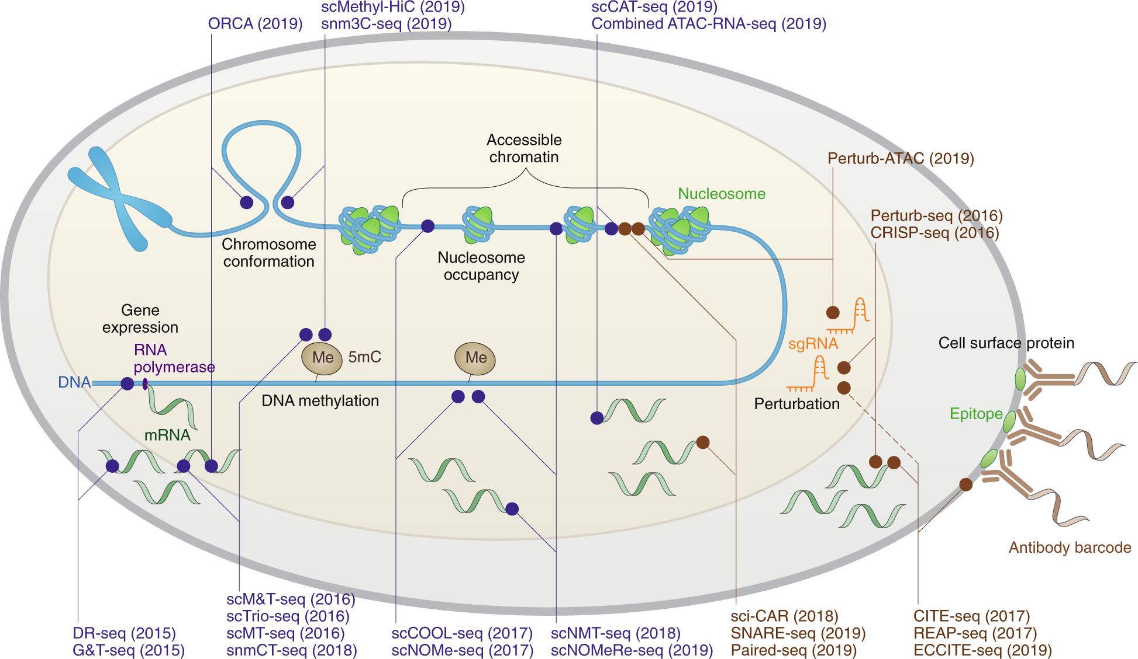
Multimodal
https://doi.org/10.1038/s41592-019-0691-5

Slide 14
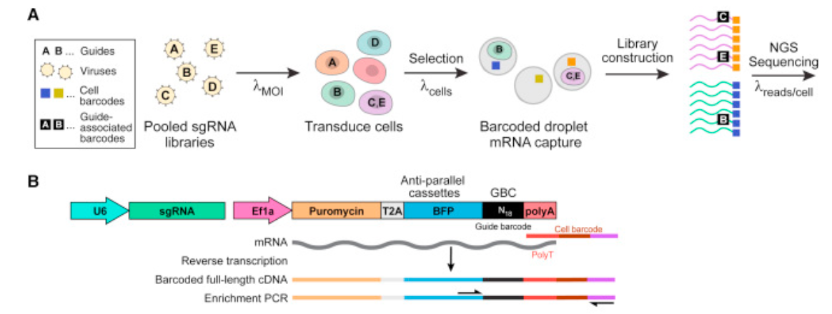
Multimodal CRISPR!
Perturb-seq
https://doi.org/10.1016/j.cell.2016.11.038

Slide 15
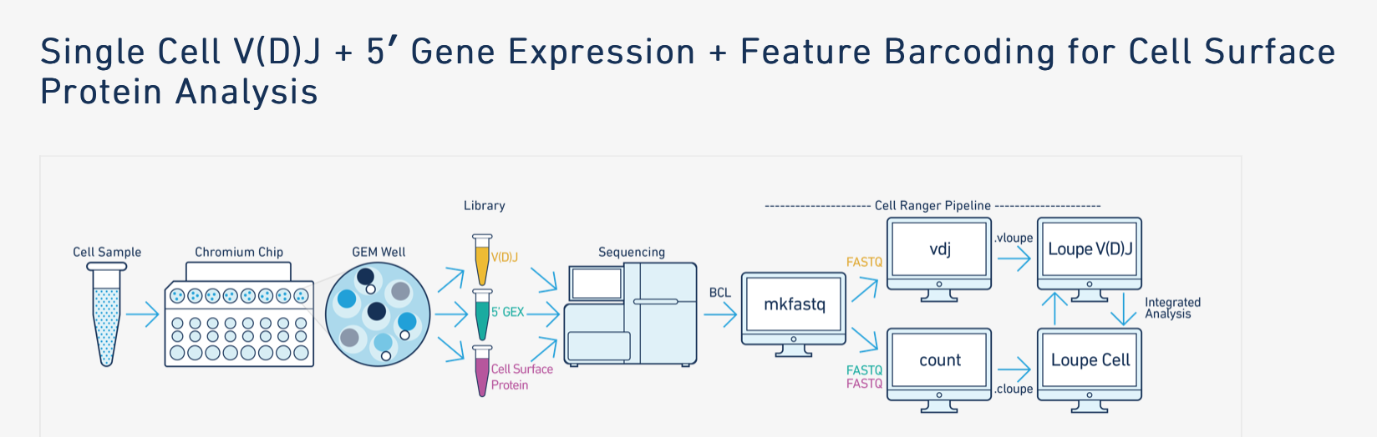
Multimodal for sale
https://support.10xgenomics.com/single-cell-vdj/software/analysis-of-multiple-libraries/latest/overview

Slide 16
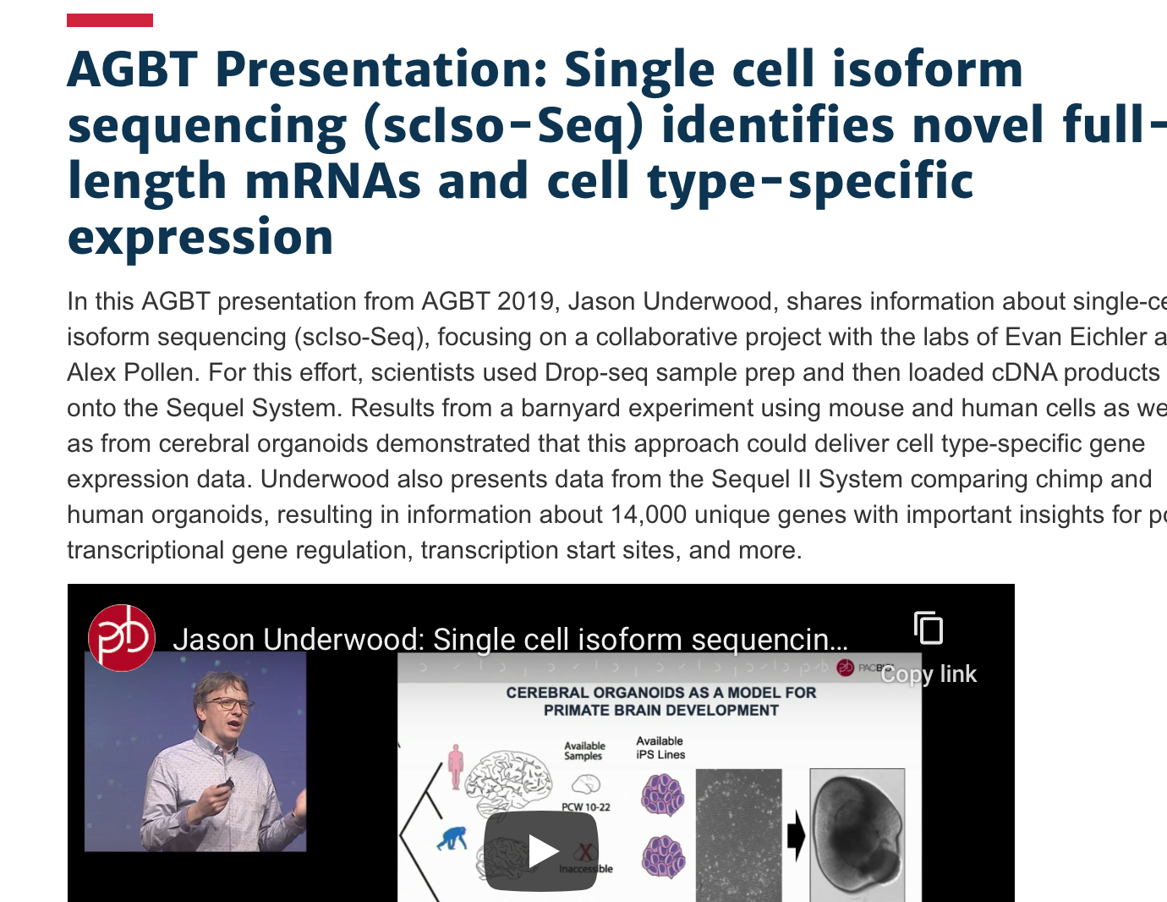
Full length

Slide 17
Spatial
Two basic approaches:
Microarray (hey they’re back!)
FISH
Review
https://doi.org/10.1038/s41576-019-0129-z

Slide 18
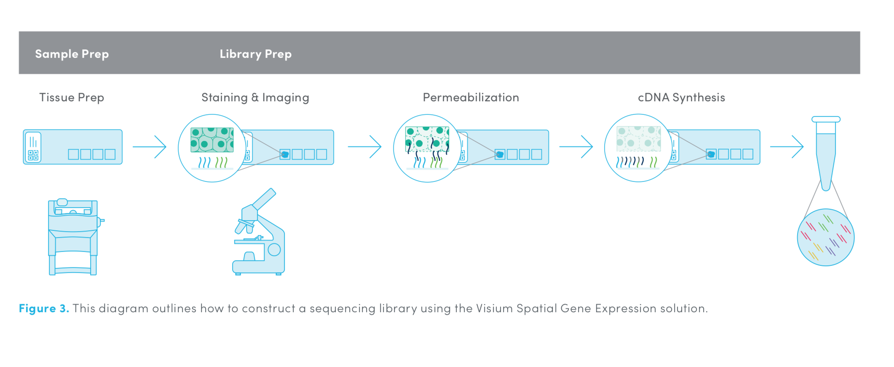
Spatial
Two basic approaches:
Microarray (hey they’re back!)
FISH
Review
https://www.10xgenomics.com/spatial-transcriptomics/
https://doi.org/10.1038/s41576-019-0129-z

Slide 19
Spatial
Two basic approaches:
Microarray (hey they’re back!)
FISH (seqFISH+ “which achieves super-resolution imaging and multiplexing of 10,000 genes in a single cell using sequential hybridizations and imaging with a standard confocal microscope.”)
https://doi.org/10.1038/s41586-019-1049-y
Review
https://doi.org/10.1038/s41576-019-0129-z

Slide 20
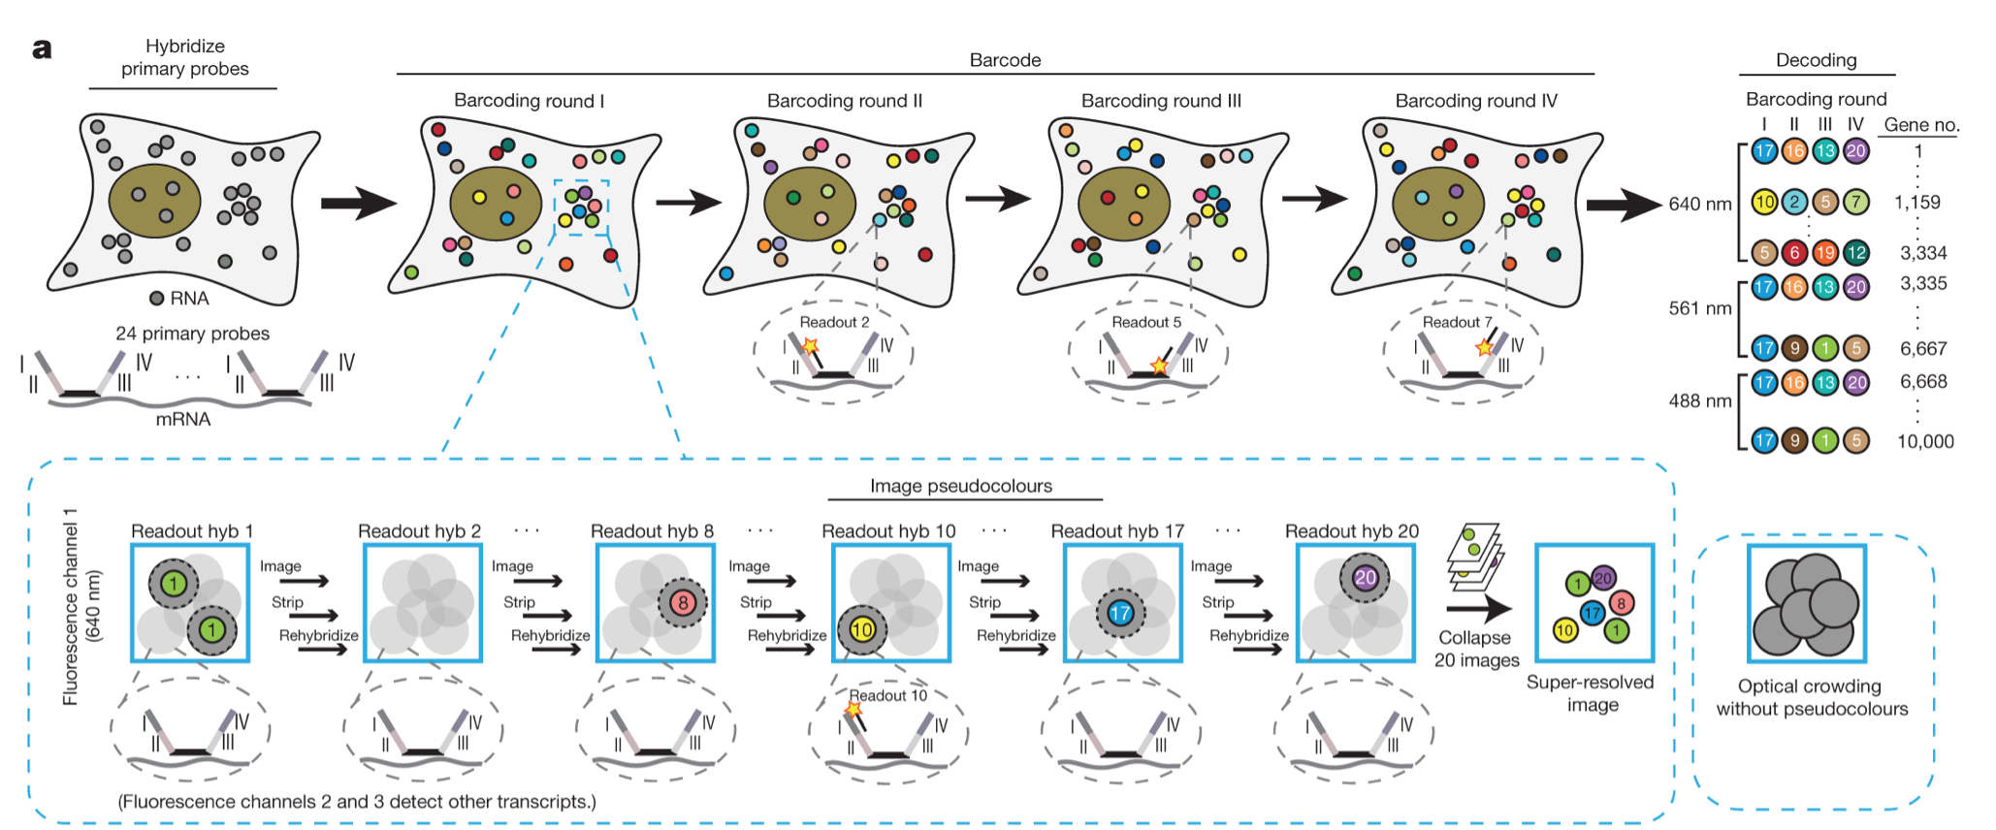
seqFISH: Combinatorial probe/colors
https://doi.org/10.1038/s41586-019-1049-y

Slide 21
Tech Time Over
Time for Analysis

Slide 22
Major
Analytic
Steps
https://www.embopress.org/doi/10.15252/msb.20188746

Slide 23
Major
Analytic
Steps
Widely accepted solution/approach
Many choices, a few are popular
Wild West
Adapted from https://www.embopress.org/doi/10.15252/msb.20188746

Slide 24
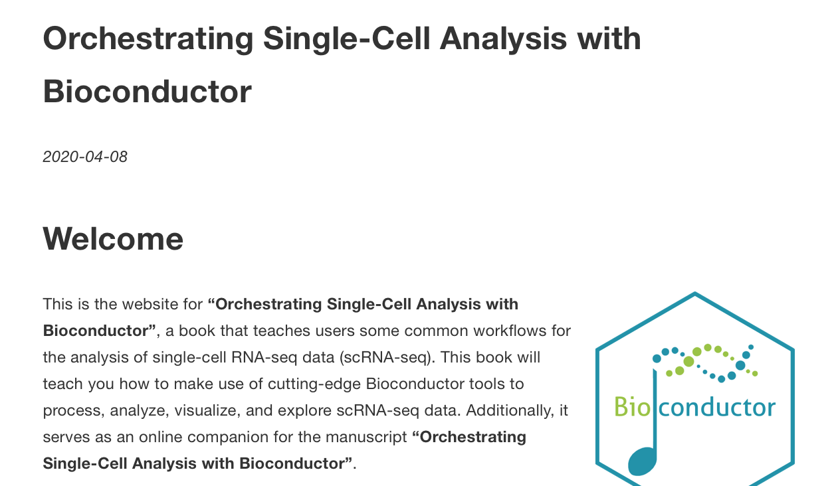
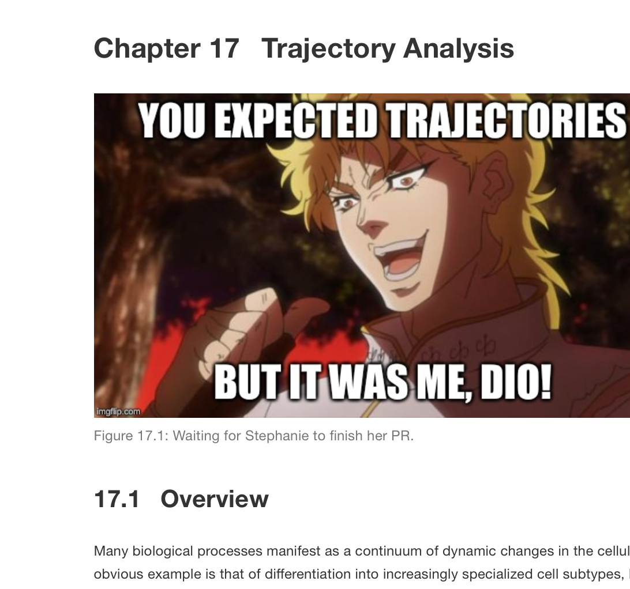


Sidebar1: Resource for sc(mostly RNA) analysis
https://osca.bioconductor.org
R based
A living resource

Slide 25
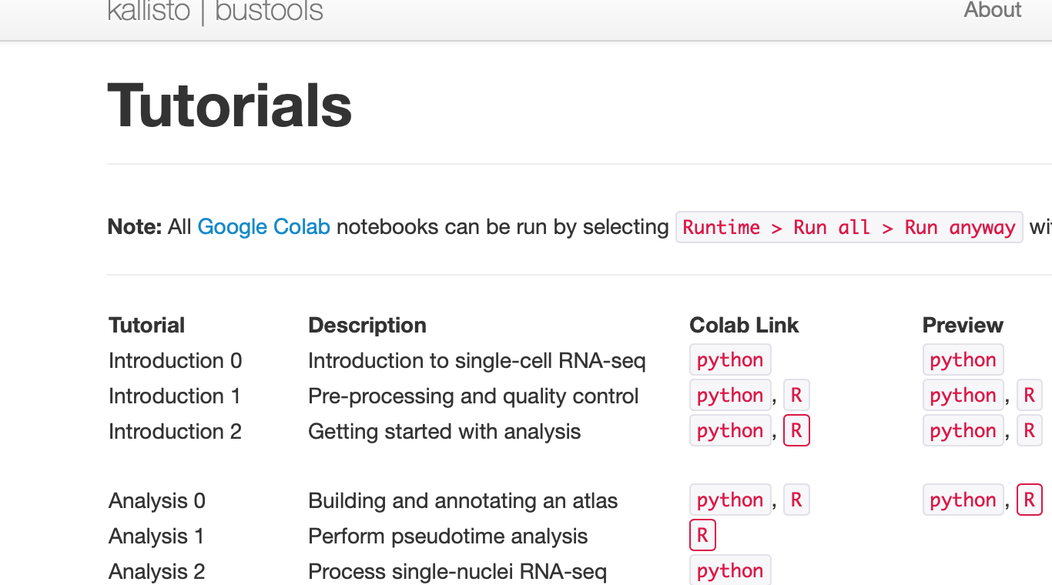
Sidebar2: kb tools
https://www.kallistobus.tools/tutorials

Slide 26
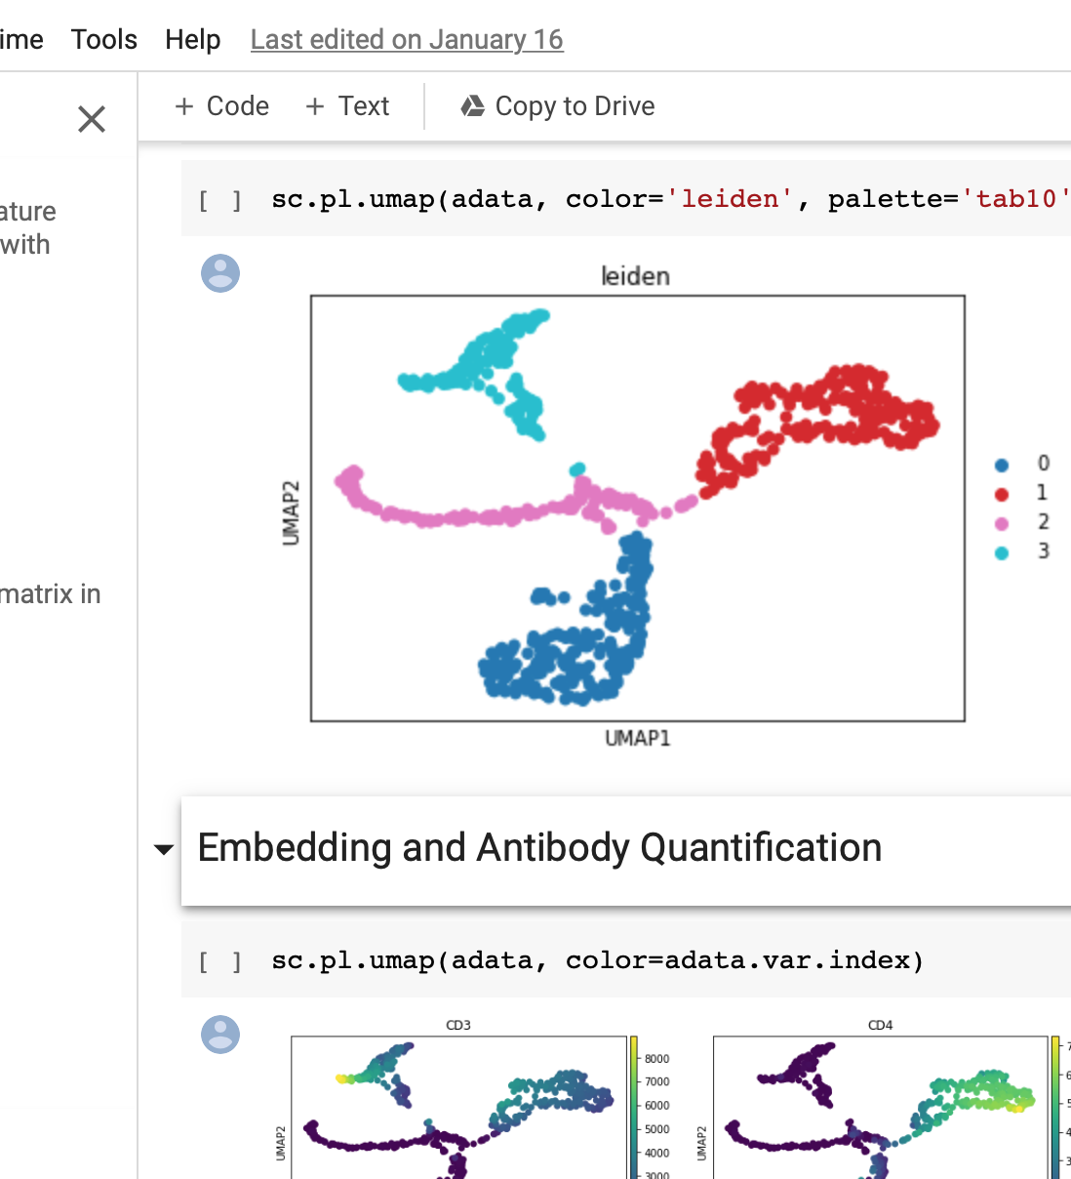
Sidebar2: kb tools
https://www.kallistobus.tools/tutorials
R and python
Dynamic tutorials hosted on interactive notebook platform
MUCH effort to make them equivalent

Slide 27
Counting (turning fastq into gene counts)
Kallisto (bustools)
pseudoalignment
(Alevin another option)
STAR
Alignment + counting
“STAR shows similar or better cell-type annotation results, by detecting a larger subset of known gene markers. However, the gain of accuracy and gene abundance of STAR alignment comes with the price of significantly slower computation time (4 folds) and more memory (7.7 folds), compared to Kallisto.”
https://doi.org/10.1534/g3.120.401160

Slide 28
Quality Control
Overarching goal is to remove “low quality” cells
Either poor library prep or cell health
Generally agreed to do the following:
Remove cells with TOO MANY* or TOO FEW counts
Remove cells with TOO FEW detected genes
If spike-ins are used, remove cells with HIGH FRACTION spike-in
Mitochondrial can be used if no spike-ins available
* Not applicable to well-based technology

Slide 29
QC Doublet ID
Some percentage (~1%?) of droplet-based methods (e.g. 10x, Drop-Seq) will get >=2 cells in a droplet
Huge # of tools and many approaches:
SNP variation
Clustering-based
Make synthetic doublets and remove cells which are ”similar”
Or just ignore and say “YOLO”

Slide 30
Dimensionality Reduction
Why do we reduce dimensions?
50,000 cells by 20,000 genes = 1 billion dimensions
Many (most?) of these dimensions are highly correlated with each other
Because the gene expression values/cell type are correlated with each other
Fewer dimensions = FAR fewer calculations downstream
UMAP (or t-SNE) visualization, clustering, and graph trajectories are all derived from the Dimensionality Reduction step

Slide 31
Dimensionality Reduction Continued
Very common to reduce the 50,000 cells to 50 PC
(related) The ”most useful” (HVG = hyper variable genes) ~2000 genes are selected
(so now we have ~50 x ~2000 = ~100,000 dims)
Three methods:
PCA (by FAR most popular)
NMF (can more directly see most relevant genes)
scVI (for use in batch correction: autoencoder)
Worthwhile to vary “PC and HVG n” to see how clustering/UMAP/graph is changed
10, 20, 50, 75 probably not crazy to try
1000, 2000 common to try
(Use lower numbers for fewer cells, clusters expected)

Slide 32
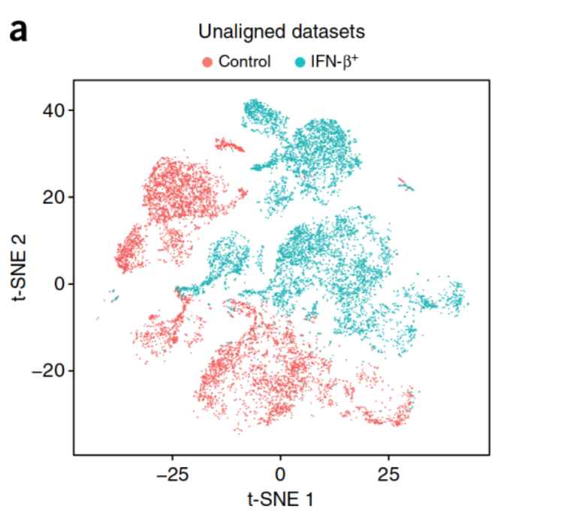
Integration / batch correction
Goal:
Remove technical variation, retain biological variation
When to use:
You have biological REPLICATES
Light reading:
https://towardsdatascience.com/how-to-batch-correct-single-cell-7bad210c7ae1
https://doi.org/10.1038/nbt.4096

Slide 33
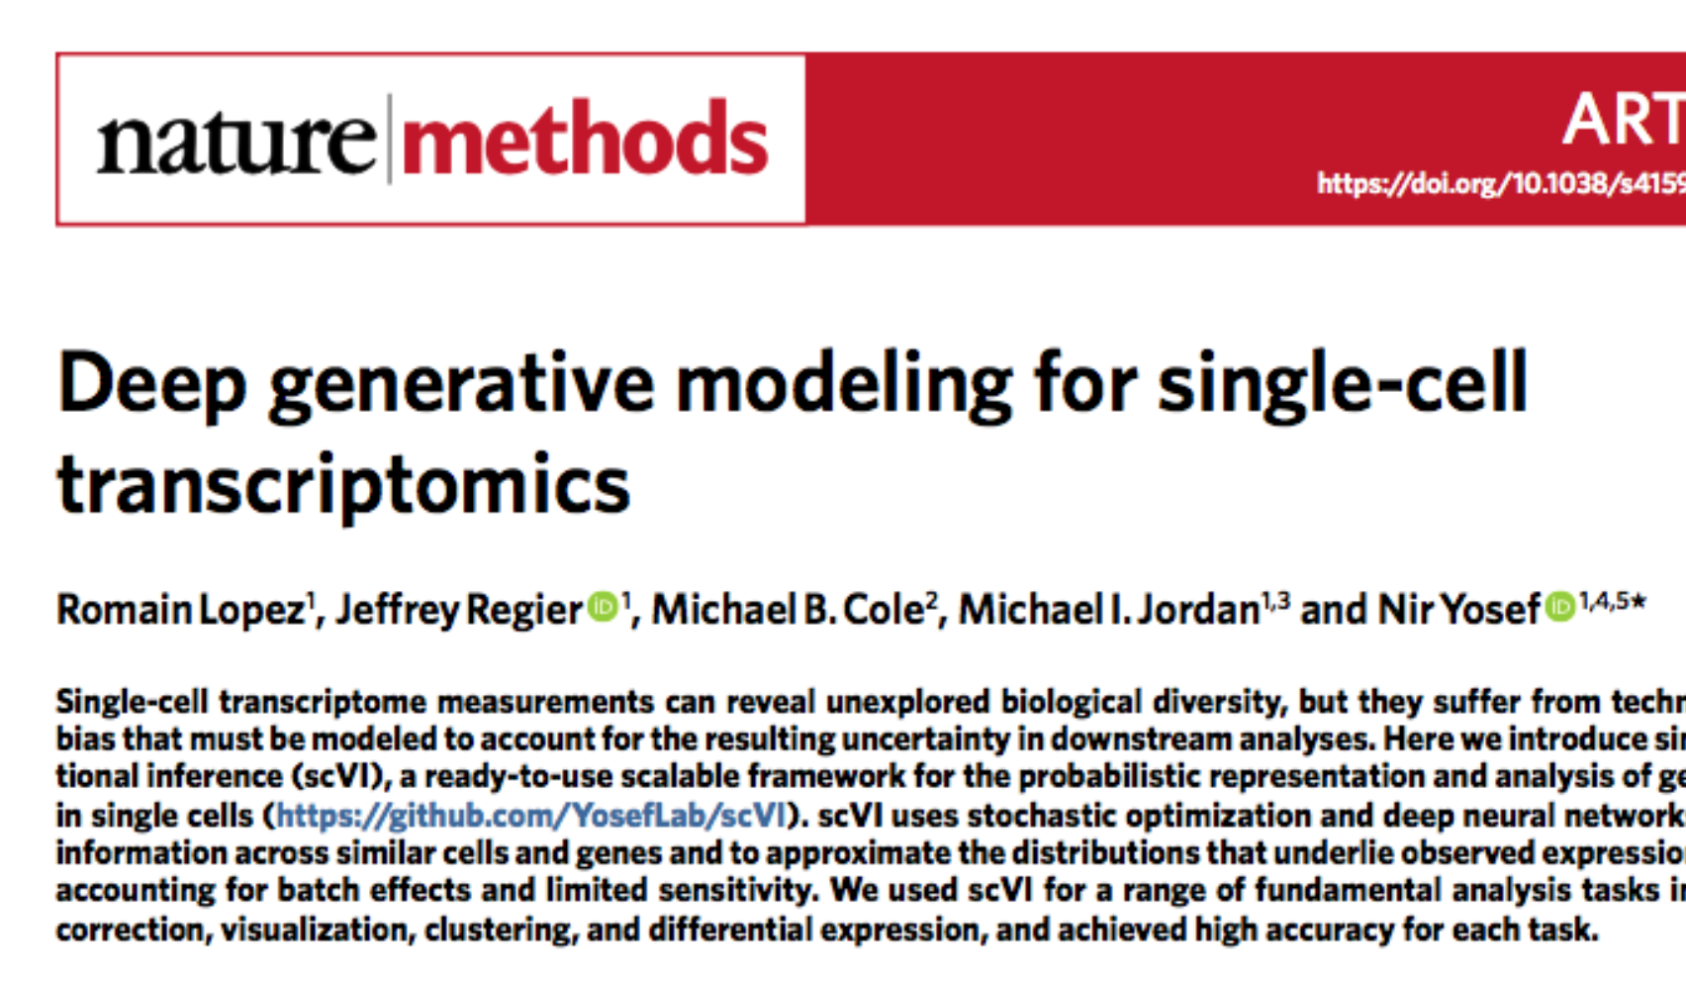
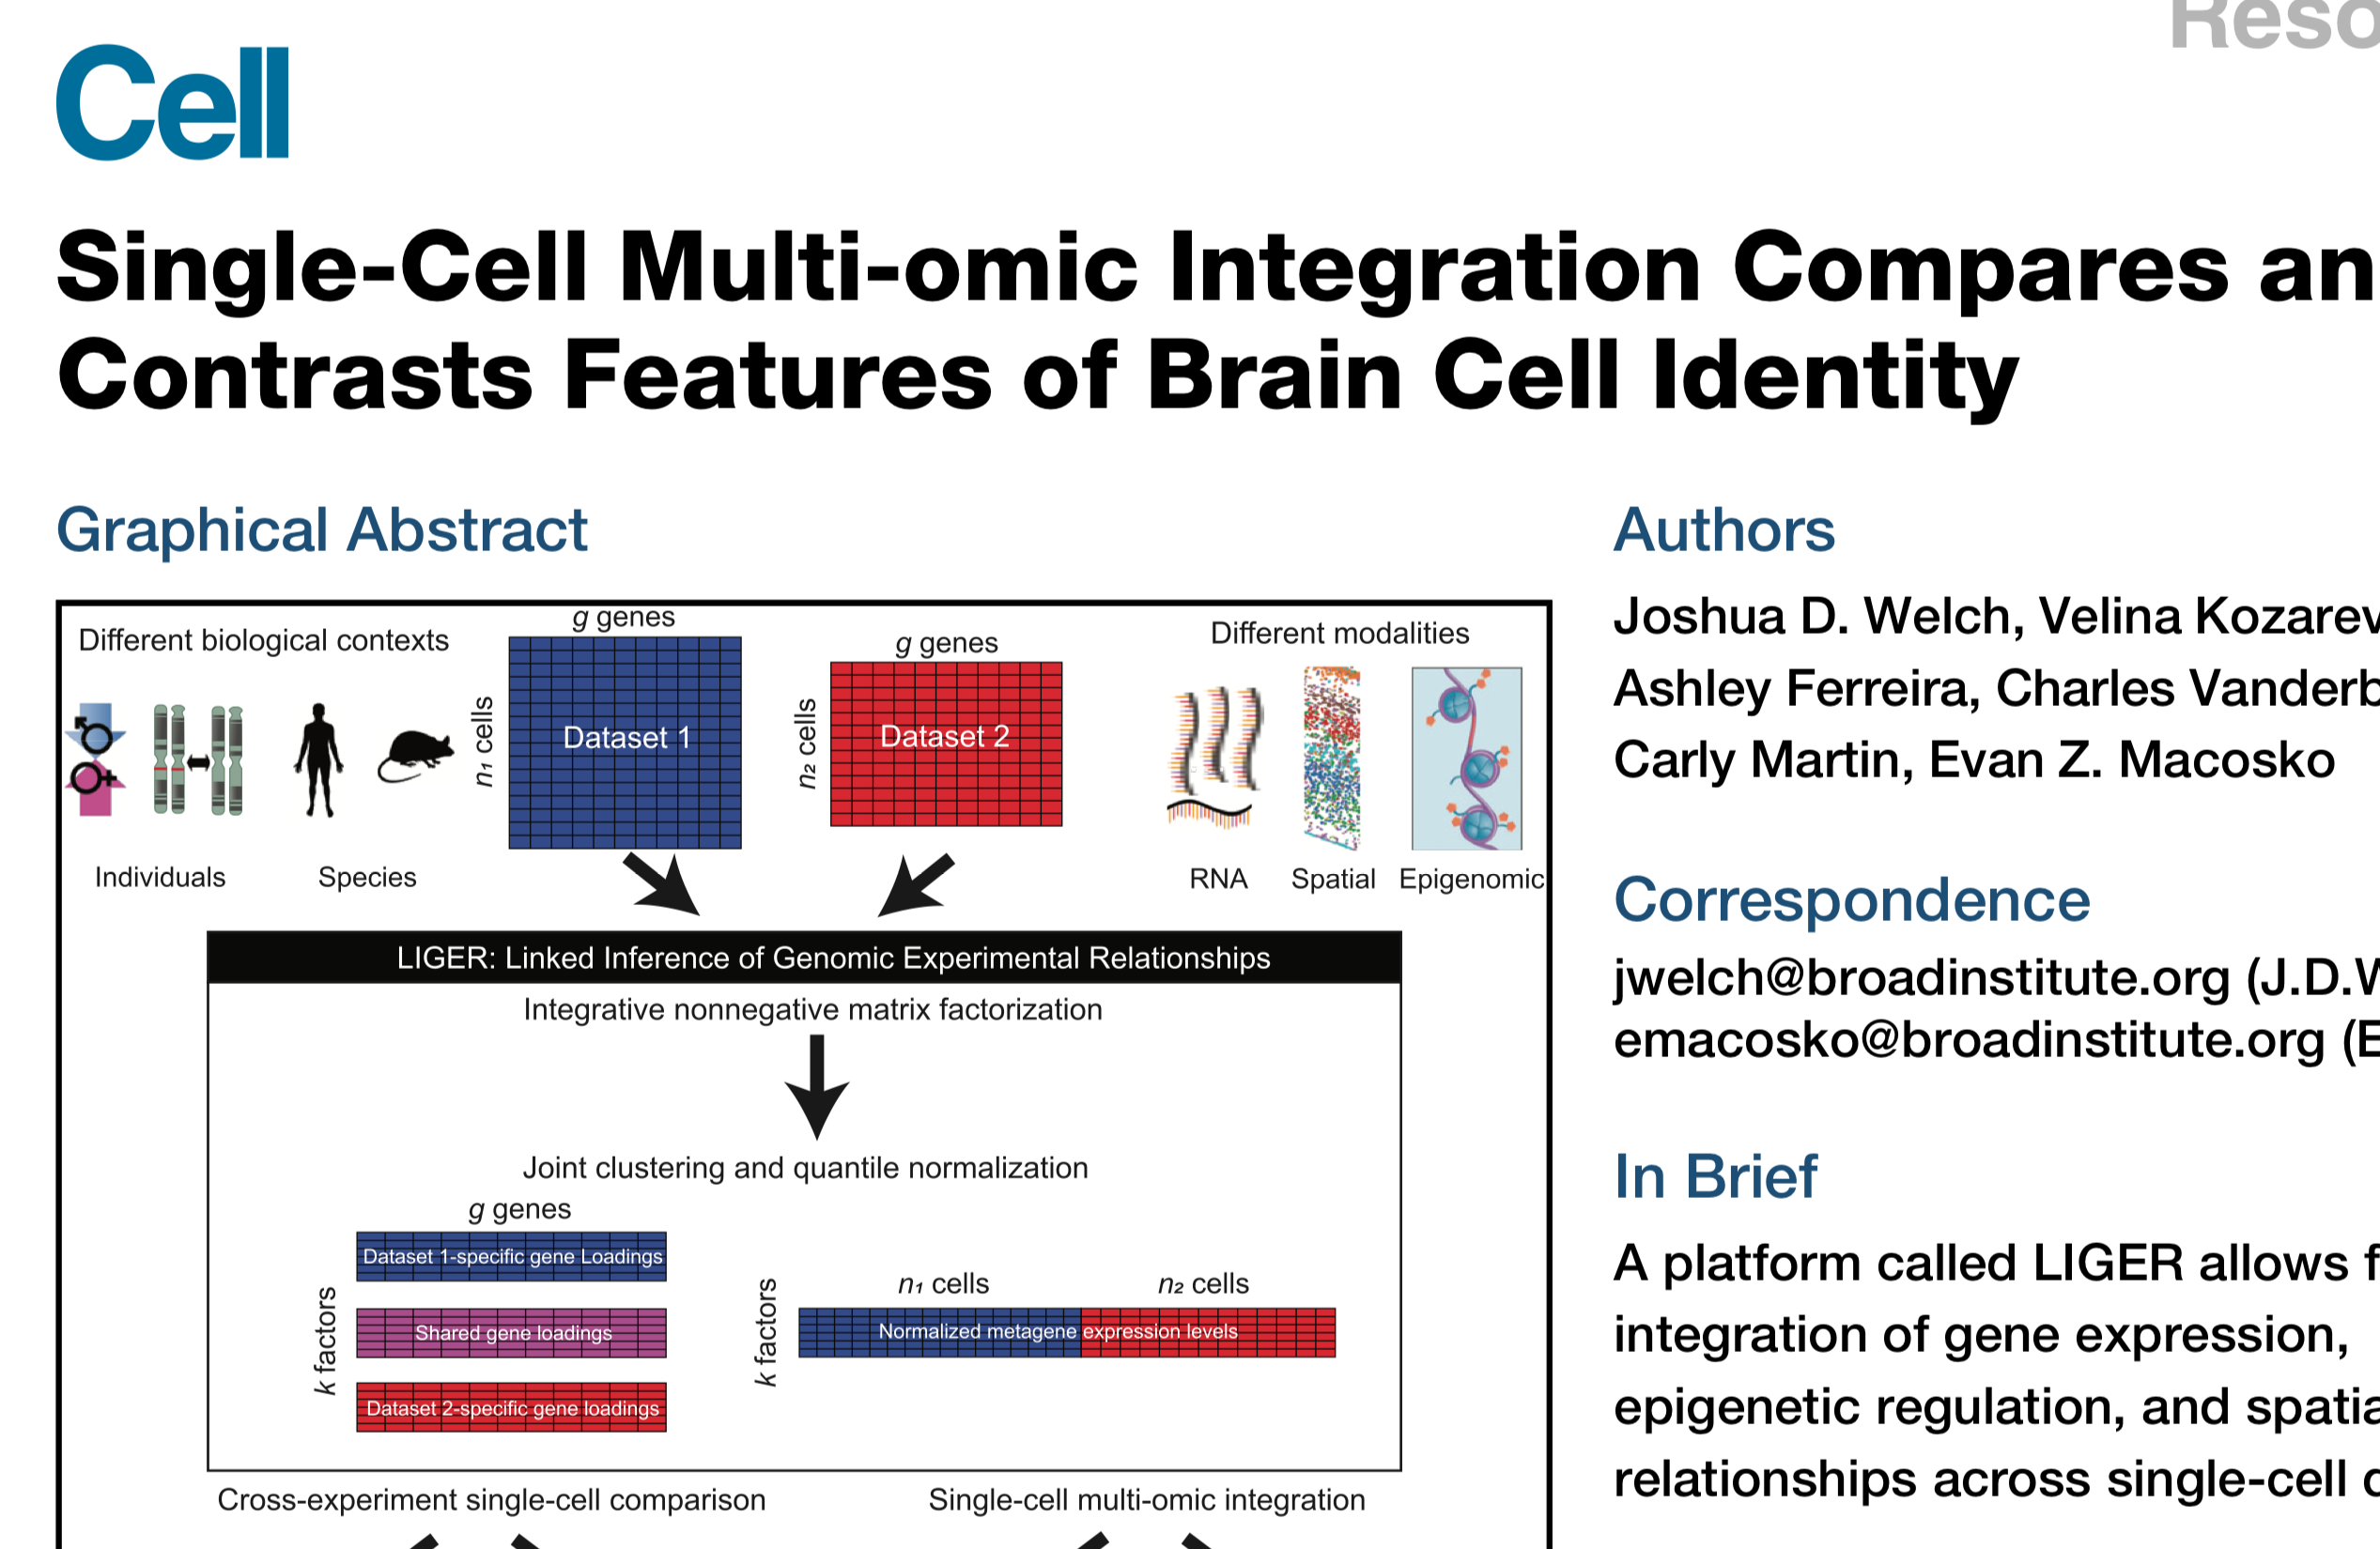
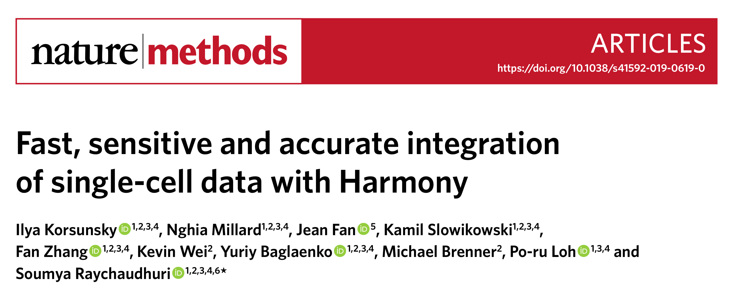
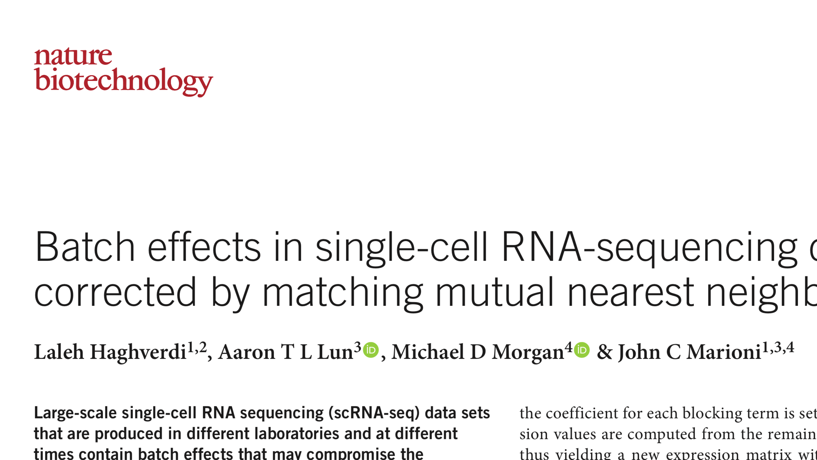
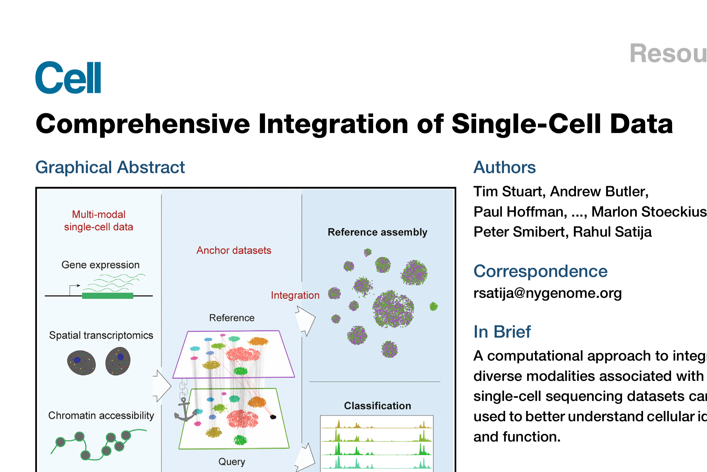
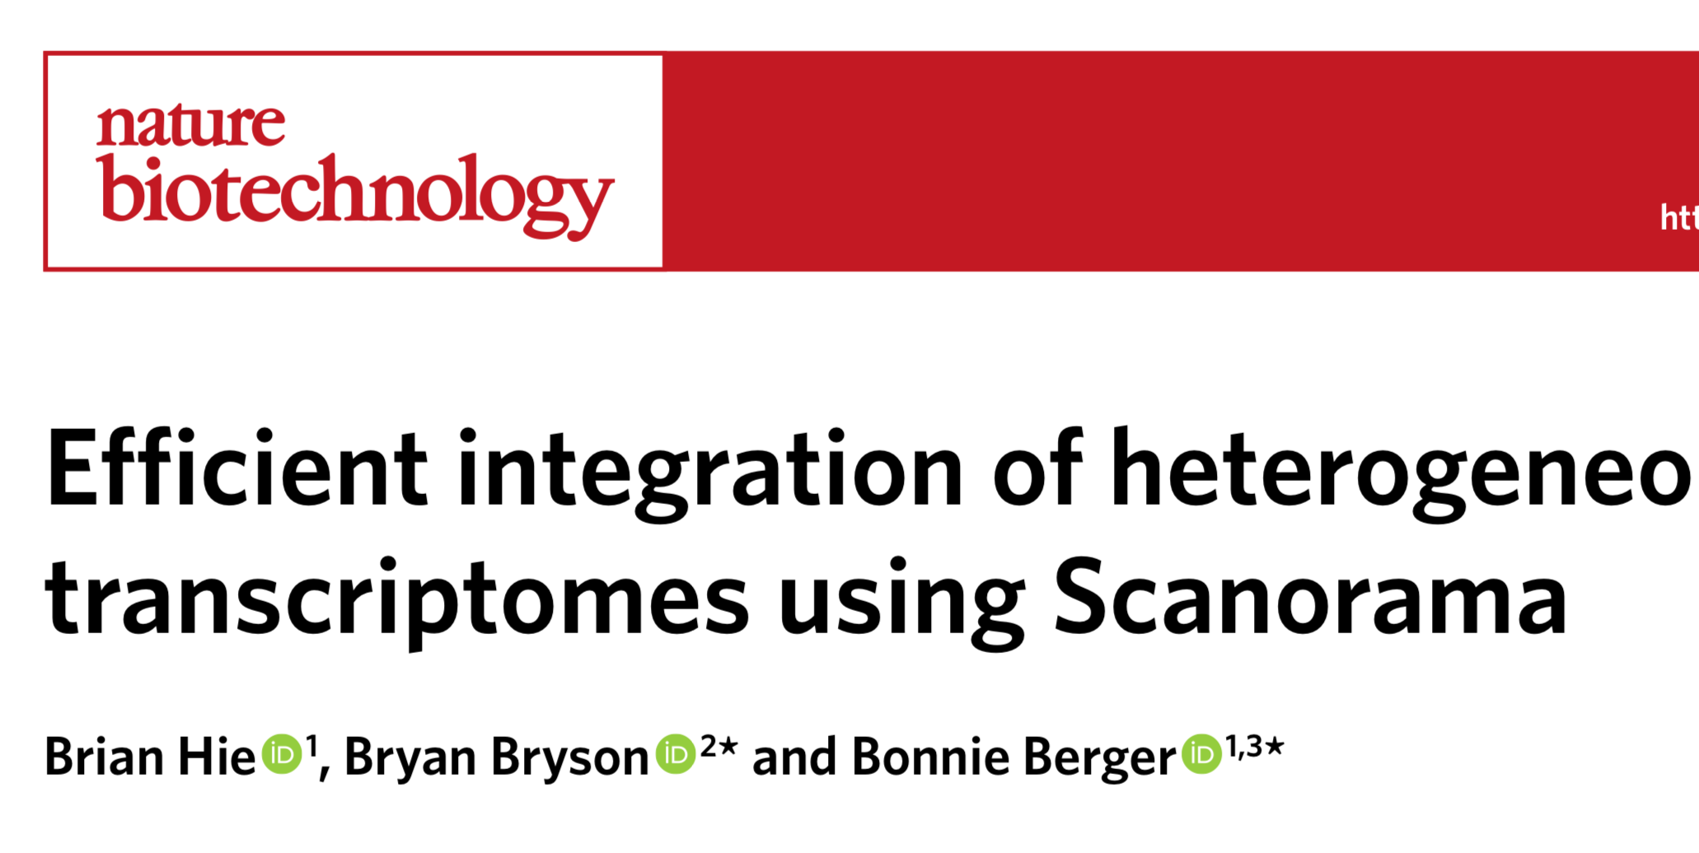
Many many methods, which Cell and Nature love to publish

Slide 34
How do they do it?
(most) work on the reduced dimensional space
Input:
Data (either raw counts (scVI) or transformed counts (all other methods)
Step 1:
Run PCA
Step 2:
PROFIT
Step 3:
Return corrected “PCA"

Slide 35
What do I recommend?
First, ONLY RUN IF YOU NEED TO!!!!
First do nothing, then color your UMAP/t-SNE by batch to see if you have a problem
Tools that have worked well for me:
Seurat CCA
FastMNN
scVI

Slide 36
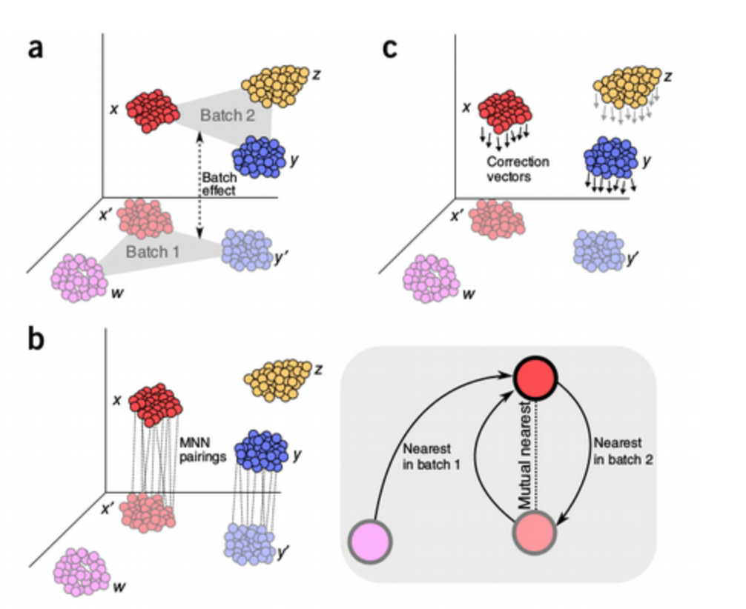
FastMNN
In PCA space (for say, 50 PC x 2000 HVG), cluster cells in each batch, then look for closest cluster in OTHER batch
Tuned to “give up” if can’t find an acceptable match
Correct each cluster
Output corrected ”PCA” for downstream use
Nice balance of performance (speed and integration effectiveness)
https://doi.org/10.1038/nbt.4091

Slide 37
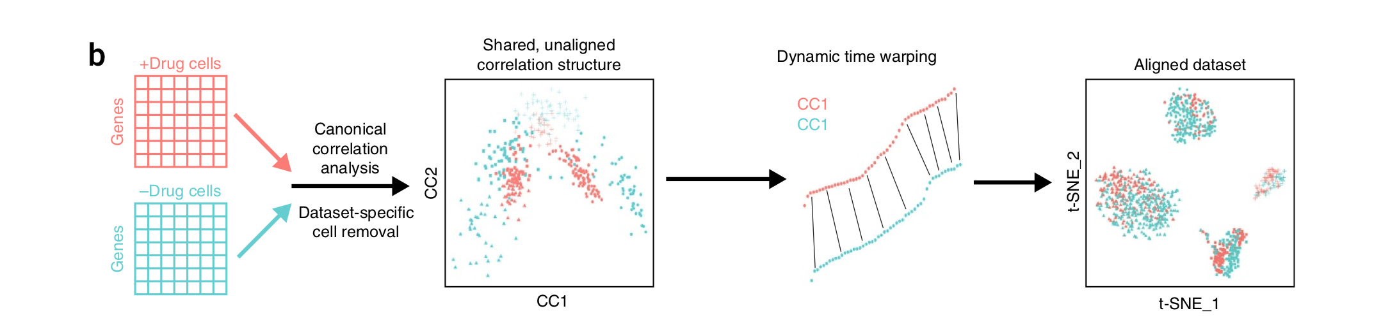
CCA
Project data into lower dimensional space and do “manifold alignment” to “stretch/shrink” to match lower dimensional patterns between batches
Assumes each batch is roughly correlated
Major downside: very slow
https://doi.org/10.1038/nbt.4096

Slide 38
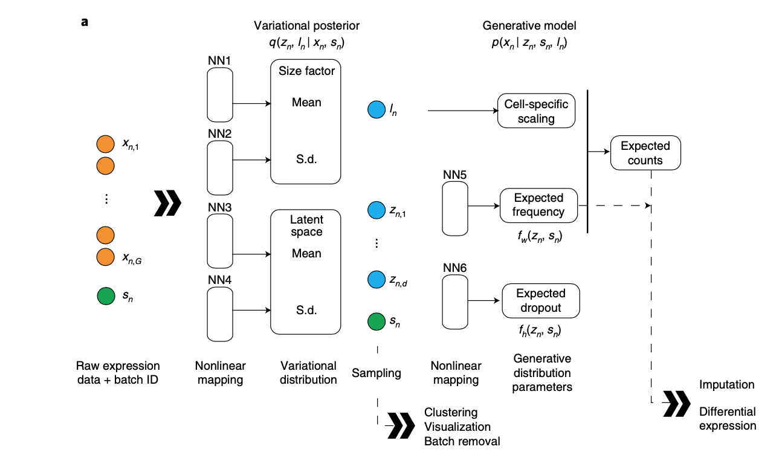
scVI
Unlike most, starts with RAW COUNTS
(Also unlike most, a python tool)
Designed for droplet/UMI (e.g. 10X, Drop-Seq) data
VERY fast
Variational autoencoder based
Learns approximation of high dimensional data in lower dimensional space
https://www.datacamp.com/community/tutorials/autoencoder-keras-tutorial
https://doi.org/10.1038/s41592-018-0229-2

Slide 39
Visualization
Goal
Go from reduced dimensional space (50 PC x 2000 HVG) to 2D (3D?)
Purpose is ONLY for human visualization
Two options:
UMAP
t-SNE

Slide 40
My suggestion
Do both, pick one
Further reading:
https://towardsdatascience.com/tsne-vs-umap-global-structure-4d8045acba17
https://pair-code.github.io/understanding-umap/
https://towardsdatascience.com/how-exactly-umap-works-13e3040e1668
Parameters to vary:
UMAP
# of neighbors (more neighbors = better global structure with worse resolution of fine interactions)
Can be surprisingly subtle
Min dist
t-SNE
Perplexity (works ROUGHLY the same as # neighbors)

Slide 41
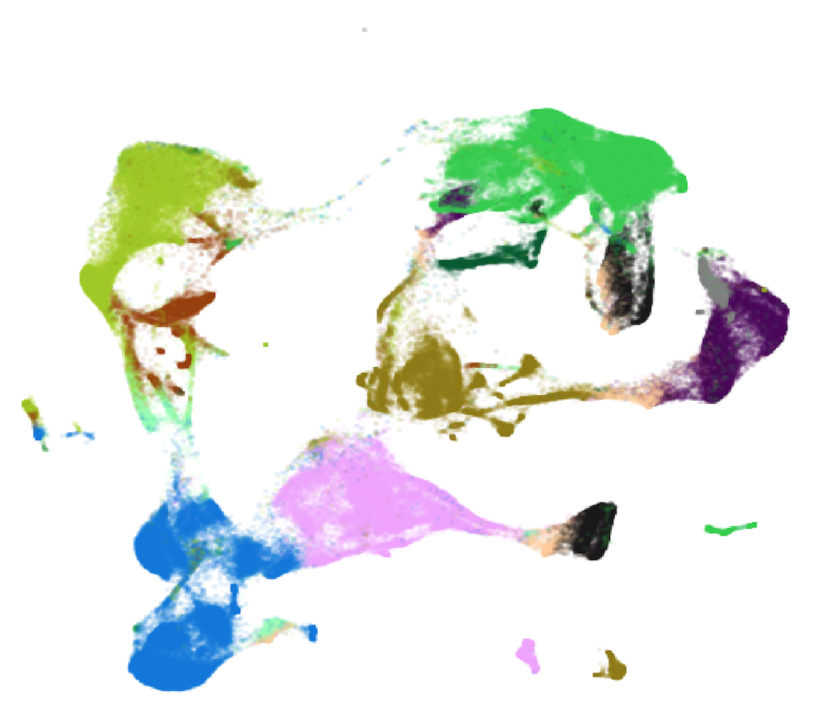

UMAP: 15 → 500 neighbors

Slide 42
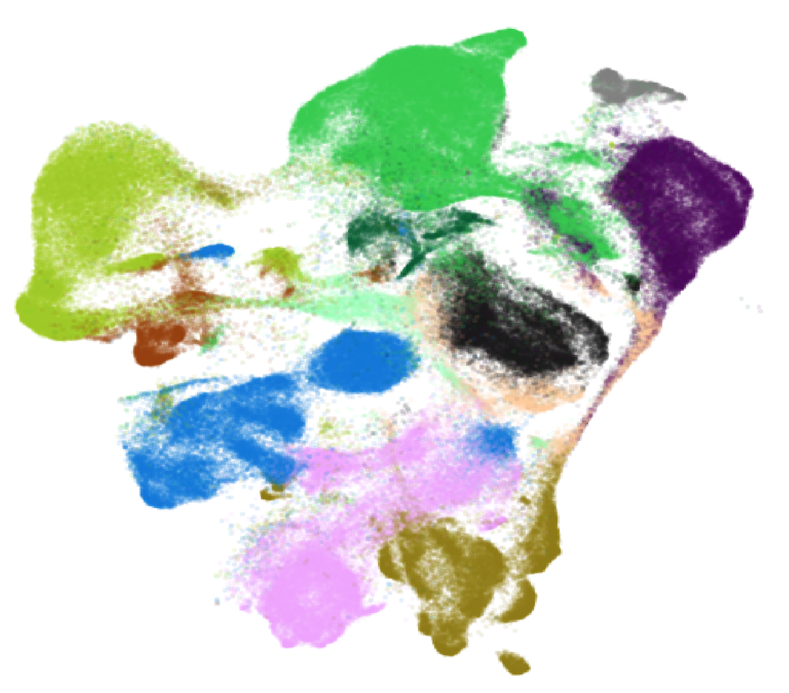
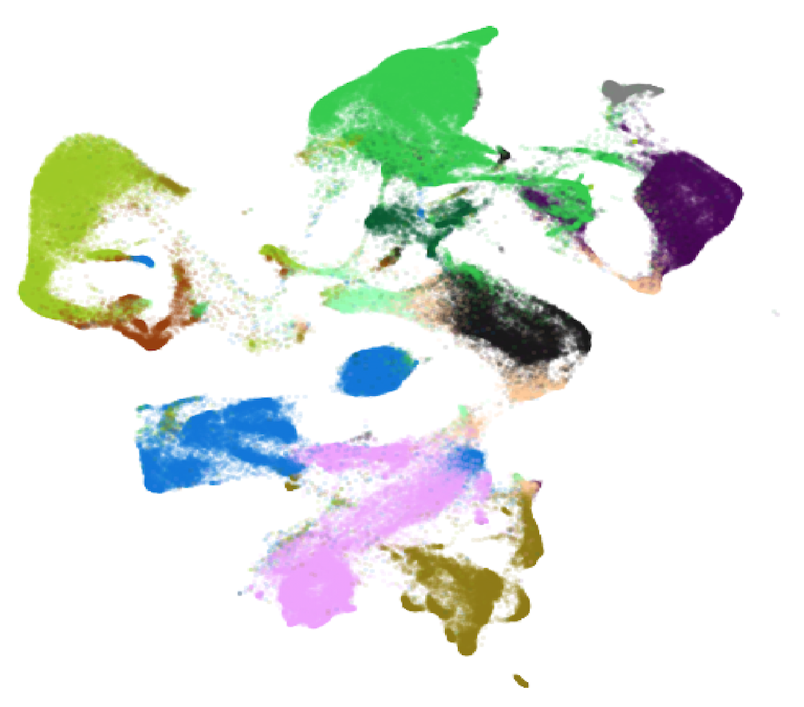
UMAP: Minimum distance (“spread”)
0.3
0.1

Slide 43
t-SNE
https://distill.pub/2016/misread-tsne/
Perplexity
Set at 50 by default
Vary between 5 and 100 (can also raise much higher if you want to try to better preserve global structure)
Major downside (compared to UMAP):
Substantially (~5X?) slower
Maybe worse at capturing global structure

Slide 44
UMAP and t-SNE are beautiful lies
Never forget – UMAP (and t-SNE) are collapsing n (where n is 10s to thousands?) of important signals into two dimensions
It may not be possible to show these relationships in 2D

Slide 45
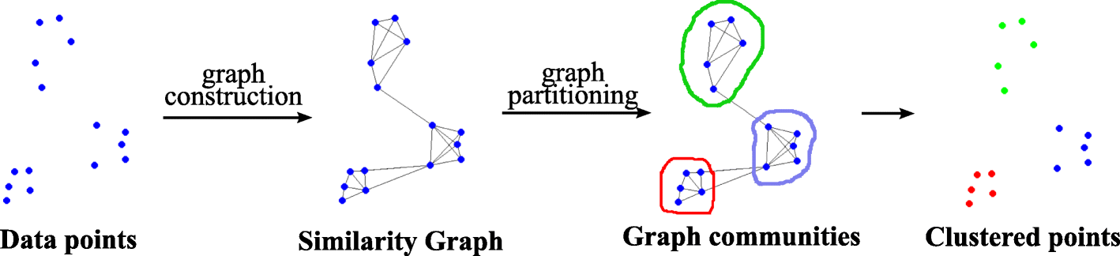
Clustering
OSCA: “Popularized by its use in Seurat, graph-based clustering is a flexible and scalable technique for clustering large scRNA-seq datasets.”
Most importantly, only uses k-nearest neighbor search
In reduced dim space, build graph with ~10 (k) neighbors for each cell
Lower/Raise k to increase/decrease total number of clusters found
Variety of popular algorithms to define clusters across the graph:
Louvain
Jaccard
Infomap
https://doi.org/10.1007/s41109-019-0248-7

Slide 46
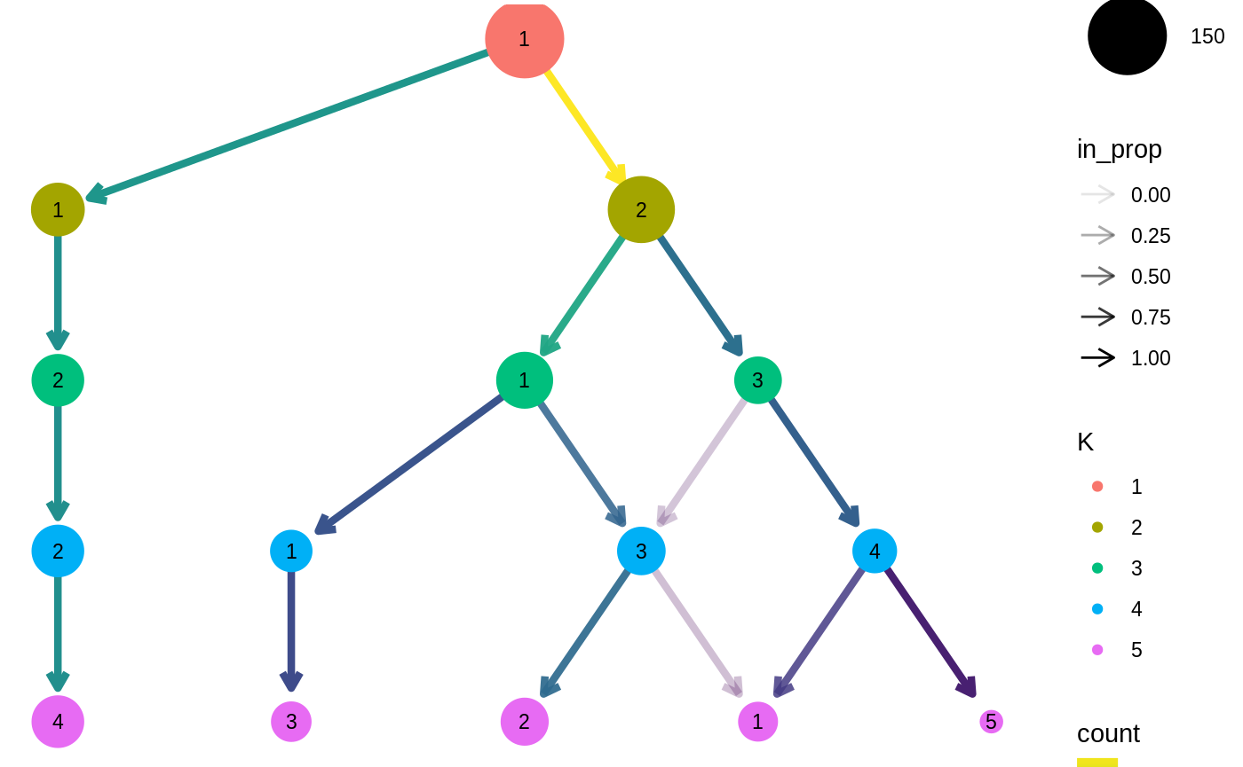
Suggestion on picking k
Clustree (Luke Zappia)
https://lazappi.github.io/clustree/articles/clustree.html
Cluster with multiple k, then visualize “stability” of clustering

Slide 47
Trajectory
Goal:
(for time/developmental series data where you believe there should be a “path” that the cells develop along)
Build trajector[y|ies] that provide a useful model for how (some) of your cells in your experiment develop
“individual cells represent points along a continuum or lineage”
Once you build the trajectory graph – you can then calculate pseudotime

Slide 48
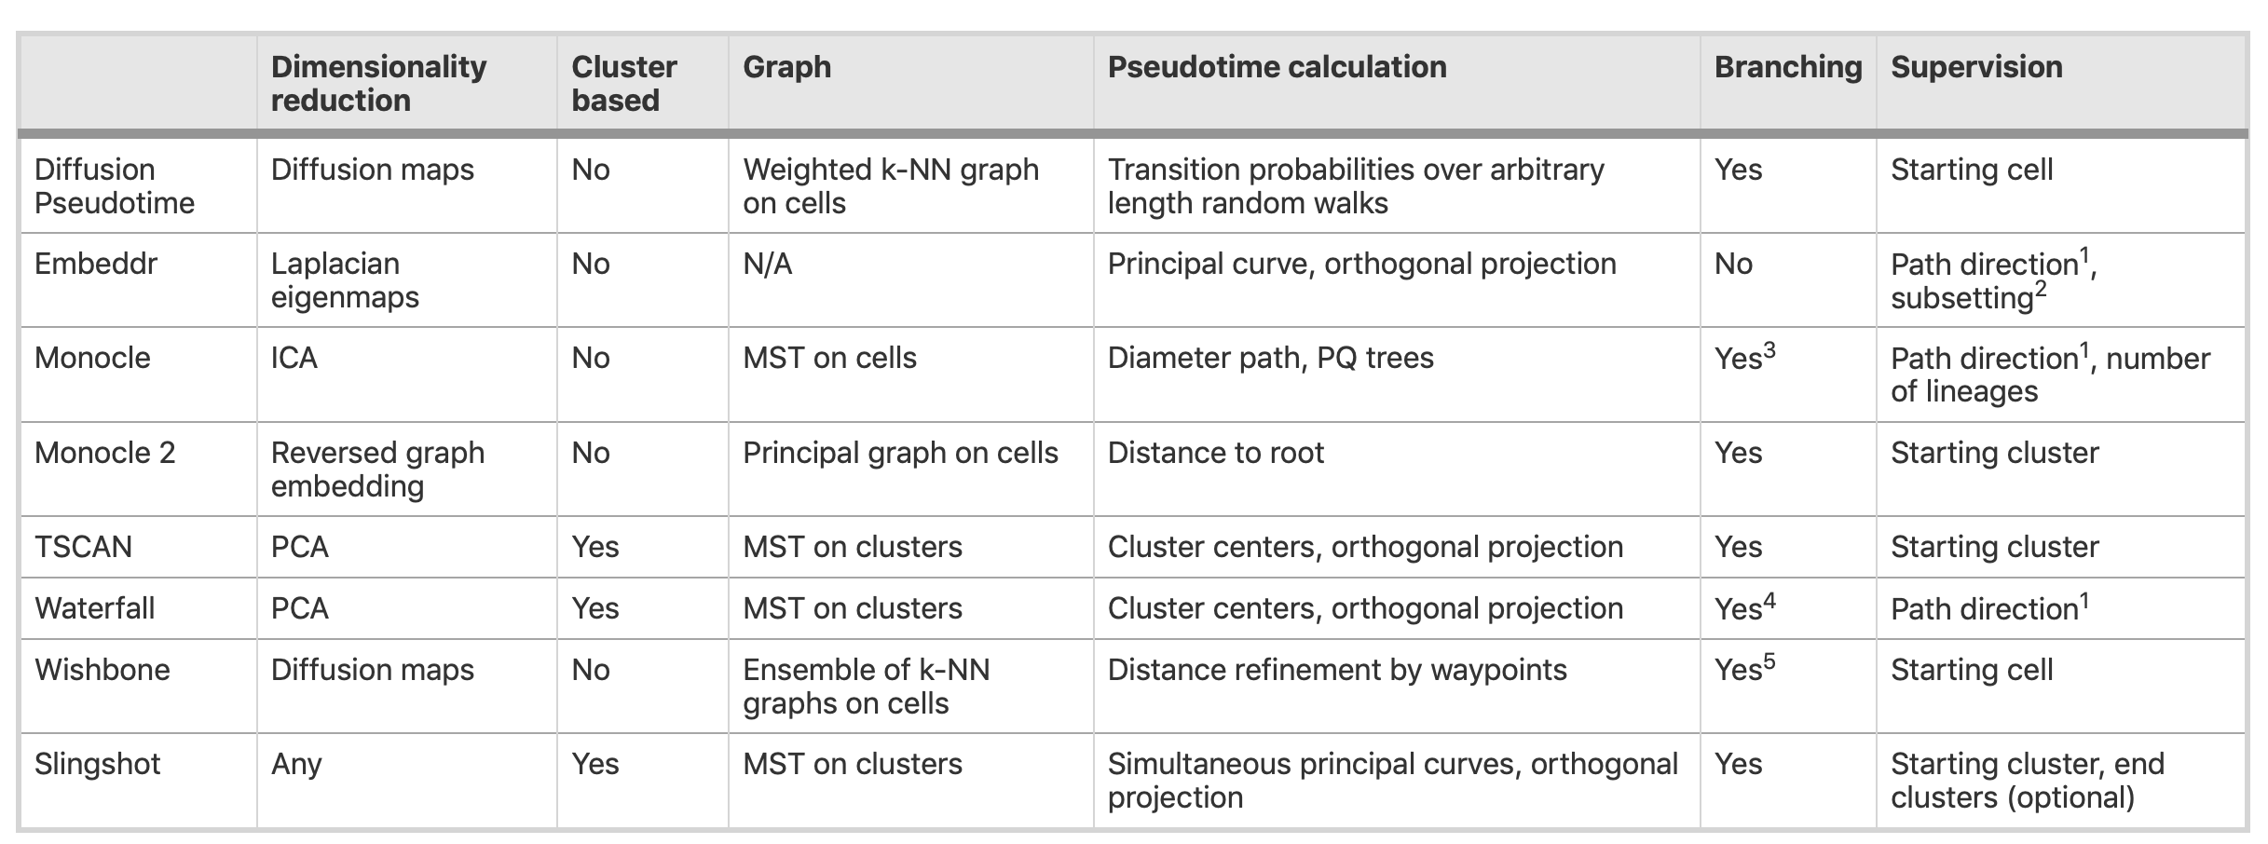
(OH MY GOD SO MANY CHOICES)
https://doi.org/10.1186/s12864-018-4772-0

Slide 49
Trajectory Tooling Trimming
Dynverse (amazing R package which wraps dozens of different methods (in Docker containers) so you can “quickly” swap in and assess different methods)
Slingshot: my favorite
Monocle (the most popular…but I dislike)

Slide 50
Dynverse

Slide 51
Monocle
…..as of early 2020, Monocle builds the graph on the 2D UMAP/t-SNE space???
Advantages:
Fast
Results closely match what you see
Disadvantages
It is safe(r) to assume that the UMAP/t-SNE representation is a warped representation
Remember you are collapsing 1 billion dimensions into 2
So the graph likely to be wrong/not useful

Slide 52
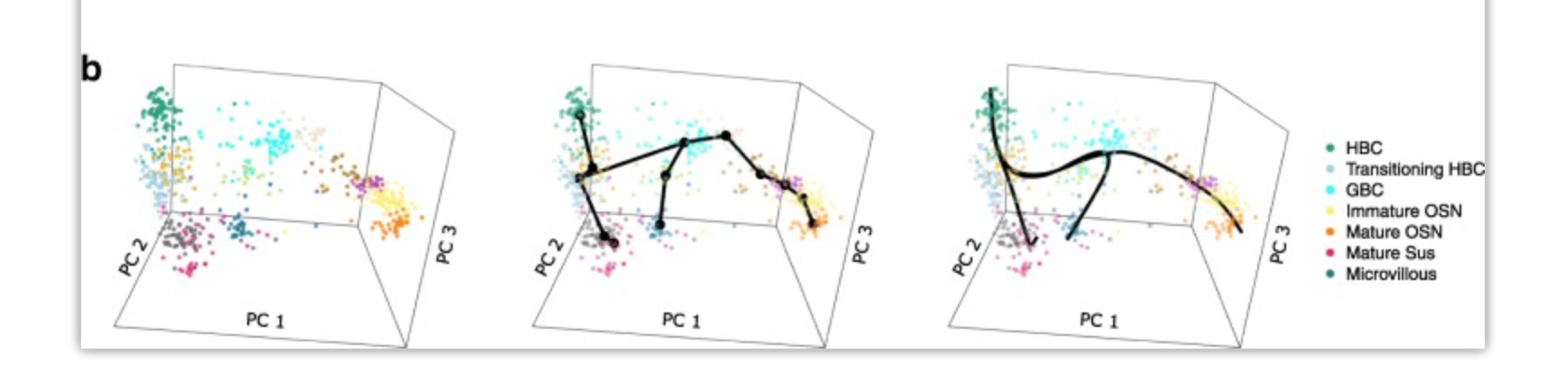
Slingshot
1. Identification of lineages, i.e., ordered sets of cell clusters, where all lineages share a starting cluster and each leads to a unique terminal cluster. This is achieved by constructing an MST on clusters of cells.
2. For each lineage, identification of pseudotimes, i.e., a one-dimensional variable representing each cell’s transcriptional progression toward the terminal state. This is achieved by a method which extends principal curves [13] to the case of multiple branching lineages.
https://doi.org/10.1186/s12864-018-4772-0

Slide 53
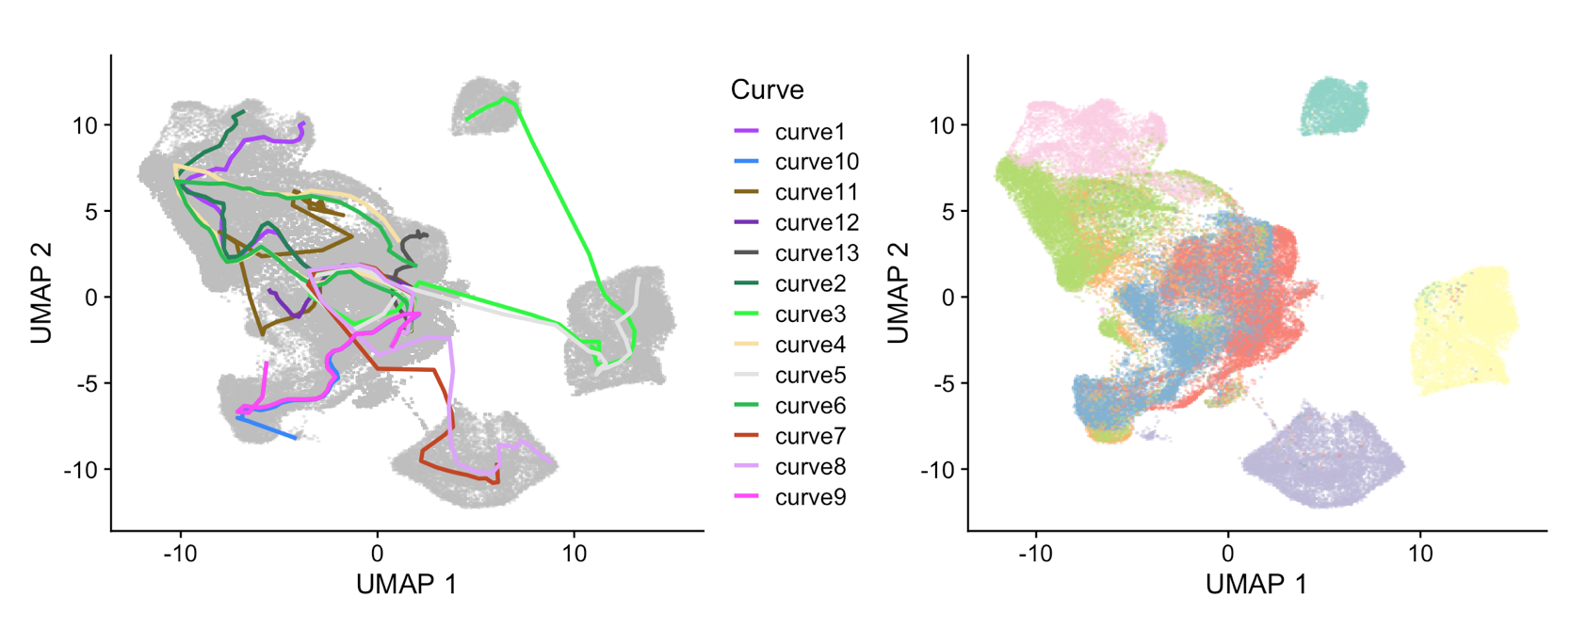
Slingshot in Practice: iPSC differentiation
0 days
End
40
25
2
20
15
10

Slide 54



Slingshot in Practice: iPSC differentiation
Desired cell type
0 days
End
Dead end
40
25
2
20
15
10
Dead end

Slide 55
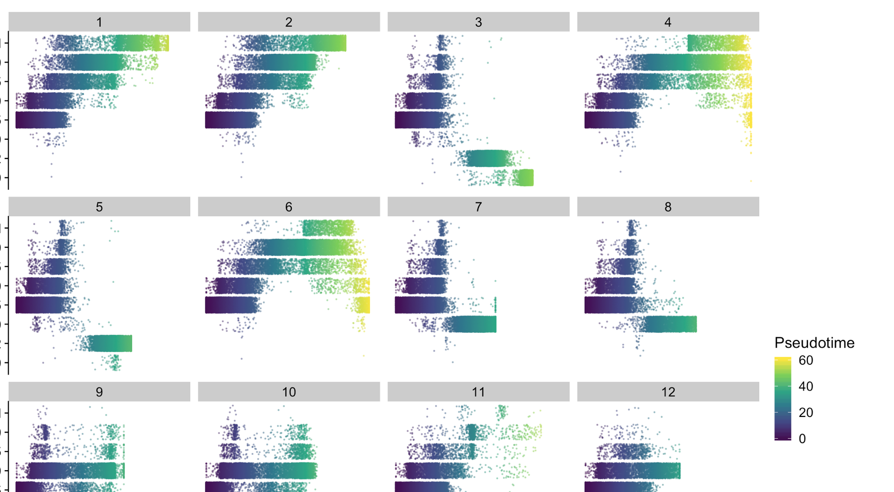
Calculate pseudotime across each trajectory
Age

Slide 56

Calculate pseudotime across each trajectory
Curve matches known time points
Age

Slide 57
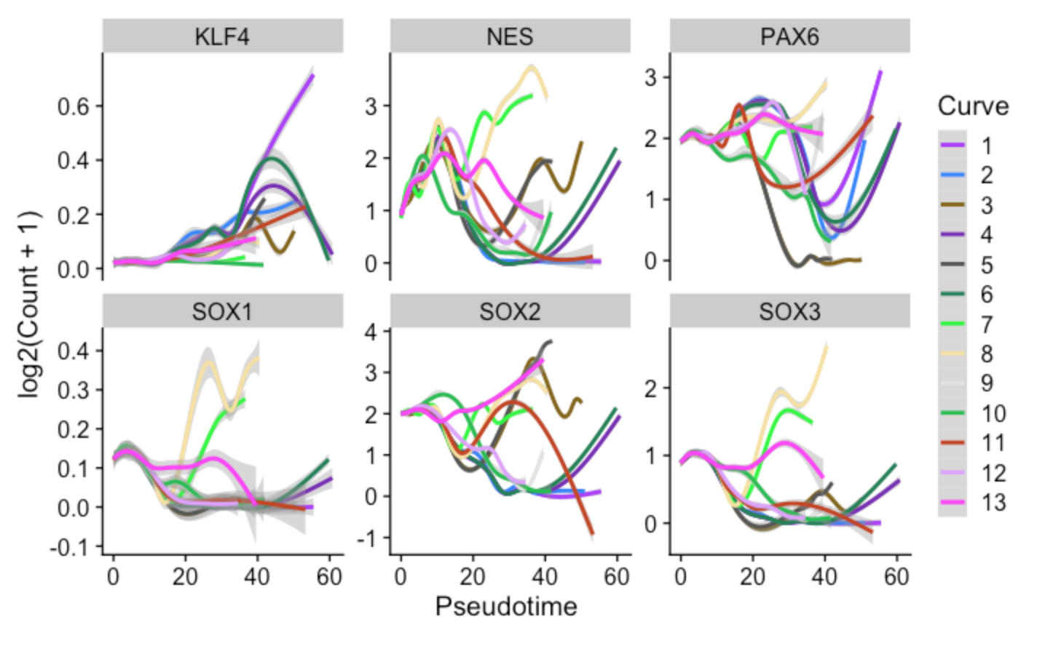
Gene expression by pseudotime across each curve
Allows you see to curve specific patterns in gene expression

Slide 58
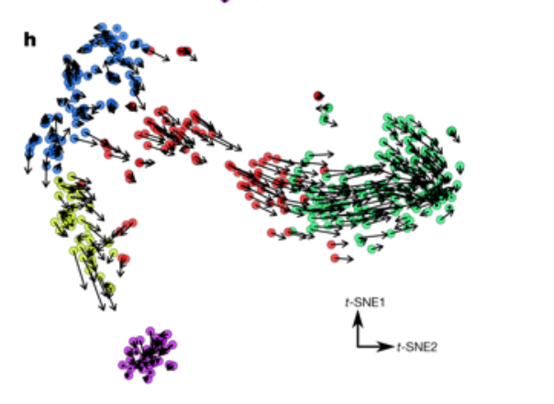
Velocity (velocyto: https://doi.org/10.1038/s41586-018-0414-6)
Review:
https://doi.org/10.1016/j.molcel.2018.09.026
Analysis example:
https://bustools.github.io/BUS_notebooks_R/velocity.html
By calculating the relative proportions of spliced and unspliced* transcripts you can infer the “activity” of individual cells
The idea is “active” cells will have higher proportion of unspliced* transcripts
Can peer into the future and infer what the mRNA expression WILL be … compare model vs reality to get direction/length of vector
* Unspliced still have introns

Slide 59
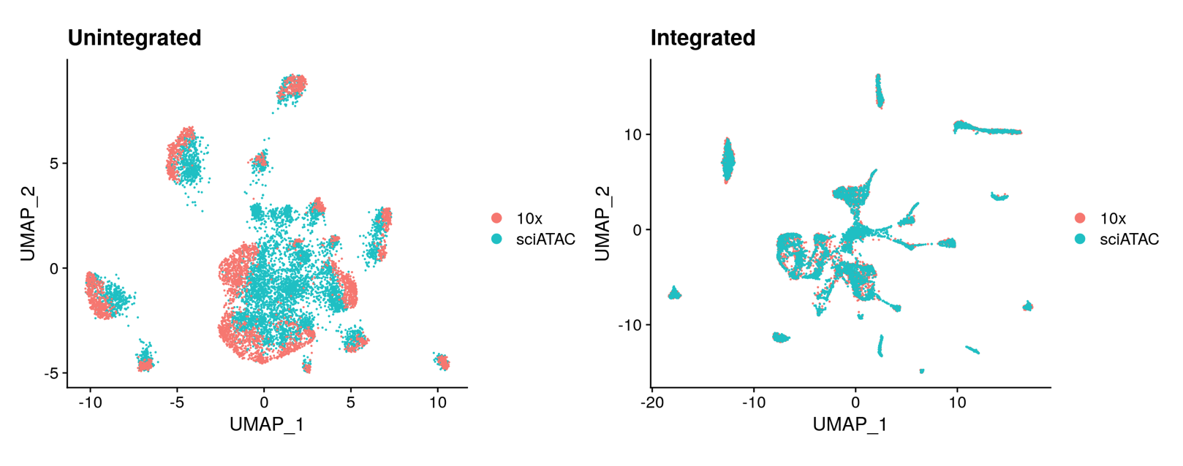
Multimodal Integration
Area of active development
Some are leveraging existing integration techniques (to do batch correction within a tech.)
Seurat/Signac:
scRNA overlaid with scATAC
https://satijalab.org/signac/articles/integration.html

Slide 60
2020 and beyond
Longer reads (PacBio leading the way…maybe ONT at some point?)
Currently PacBio better for long read RNA bc of better bp accuracy
More multiomic (in the same cells?)
ATAC + Methlyation + Cell Surface Proteins + RNA + ….
Spatial (all the above..but you will get 3D/4D position at increasingly precise resolution)
Massive Perturbation (CRISPR for you! CRISPR for all of your cells!)
Generally: EVERYTHING IS GOING QUANTITATIVE

Slide 61
Good news!
Companies are providing (or will provide) kit solutions for many of these emerging technologies

Slide 62
Bad news
Bottlenecks will be:
Tissue (rare, time points, iPSC diff times, model organism mutagenesis)
This is no different
ANALYSIS
These new techs generate HUGE amounts of data…. Which require substantial expertise (and compute) to analyze, ESPECIALLY when combing across technologies, datasets (multimodal)
Important to ensure you have adequate analytic backbone and emphasize ability/readiness of trainees to learn

Slide 63
FIN

